Slide 1
For Live Session Assignment (FLS)
Unit 1

Slide 2
Philosophy
On the following slide(s) you will see activities and the estimated / expected time that the student should spend on that activity.
It is important to note that the goal of the activities is to become familiar with the methods, ideas and implementation involved in that activity so that we can efficiently iron out all the details in live session.
Analogy: You are building the pieces of puzzle in the For Live Session Activity and we are putting them together to see the big picture in live session.
It is not expected that the student have all the correct answers. The expectation is that each student spend the allotted time (indicated next to the activity) on each activity so that we can discuss the details in live session.
If you max out the indicated time without finishing the activity and you don’t have more time to finish, simply write up what you have learned by that time and record any questions you might have and we will address those in live session!
We want to develop the questions before live session so that we can use the live session time to effectively answer them!

Slide 3
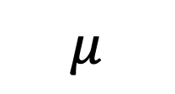

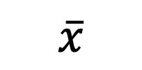

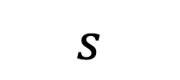
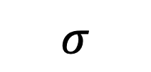
Symbols!
Standard Deviation
Mean
Variance
$$μ$$
$$σ$$
$$σ^{2}$$
Population
PARAMETERS
Sample
$$\overline{x}$$
$$s$$
$$s^{2}$$
STATISTICS

Slide 4
Let’s ask another question…
We throw a vintage clothing and housewares convention and would like to know the average net income of those who are attending. This will help us advertise to potential retailers for next years convention!

Slide 5
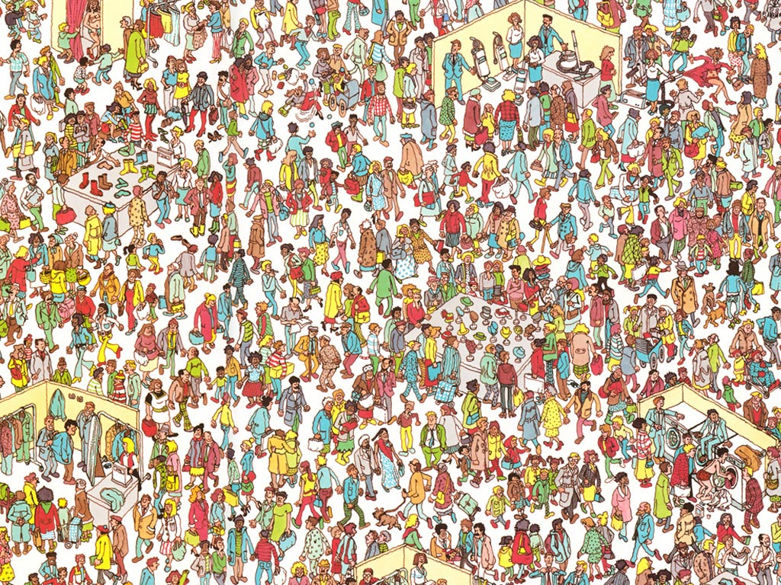
Definitions
Population
the complete collection of all elements (scores, people, measurements, and so on) to be studied. The collection is complete in the sense that it includes all subjects to be studied.

Slide 6
Definitions
A Census takes a long time and can be very costly! Let’s take a random sample and let that estimate the population’s mean net income.
Census
the collection of data from every member of the population.
Sample
a sub-collection of elements drawn from a population.
We will ask each and every one of them!!!

Slide 7
Key Concepts
Sample data is most useful when collected in an appropriate way, such as through a process of random selection.
A random sample is one in which every member of the population has an equal probability of being included in the survey.
If a sample is not taken at random, we run the risk of obtaining a biased estimate.

Slide 8
Definitions
Bias
A statistic is biased if it is calculated in such a way that it is systematically different from the population parameter of interest.

Slide 9
When we take a random sample, we guard against bias by taking a sample that is likely to be representative of the entire population.

Slide 10
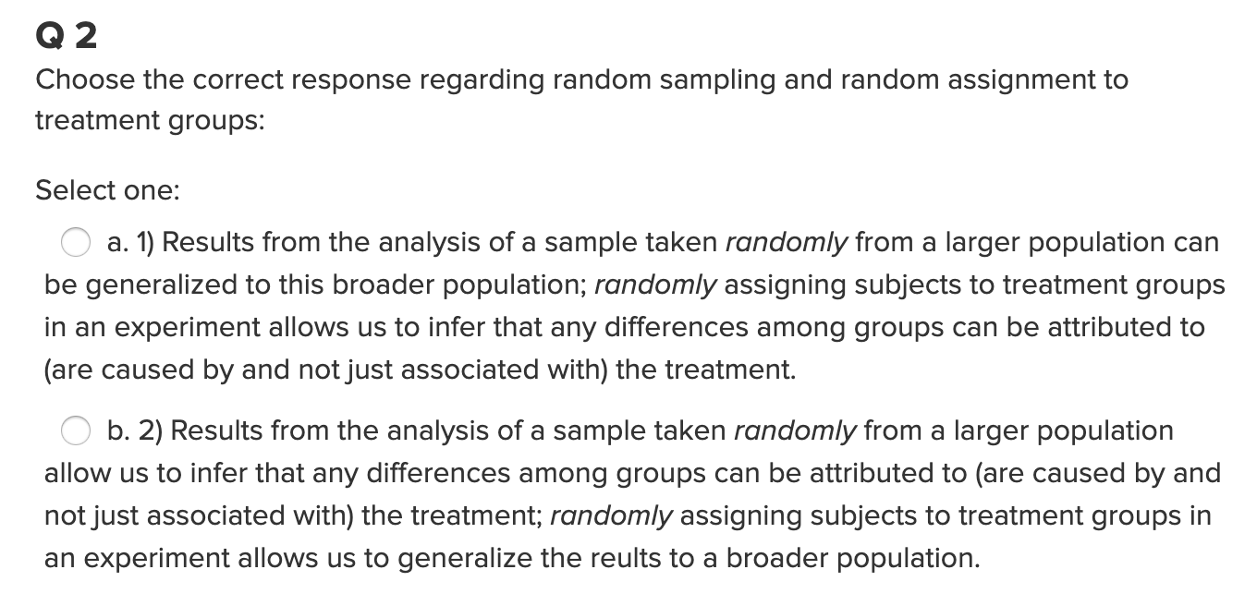
Quick Quiz Question 2 (QQ2)

Slide 11
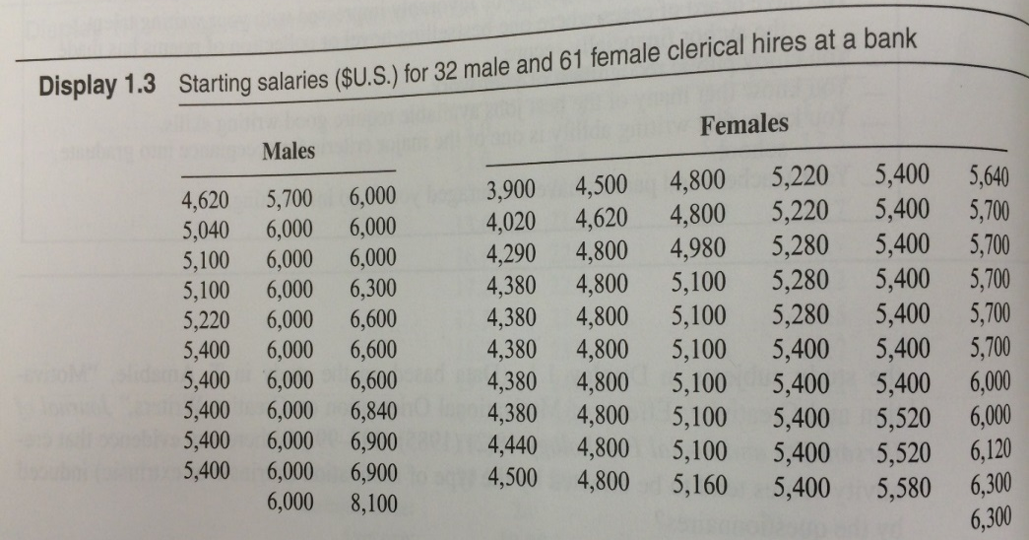
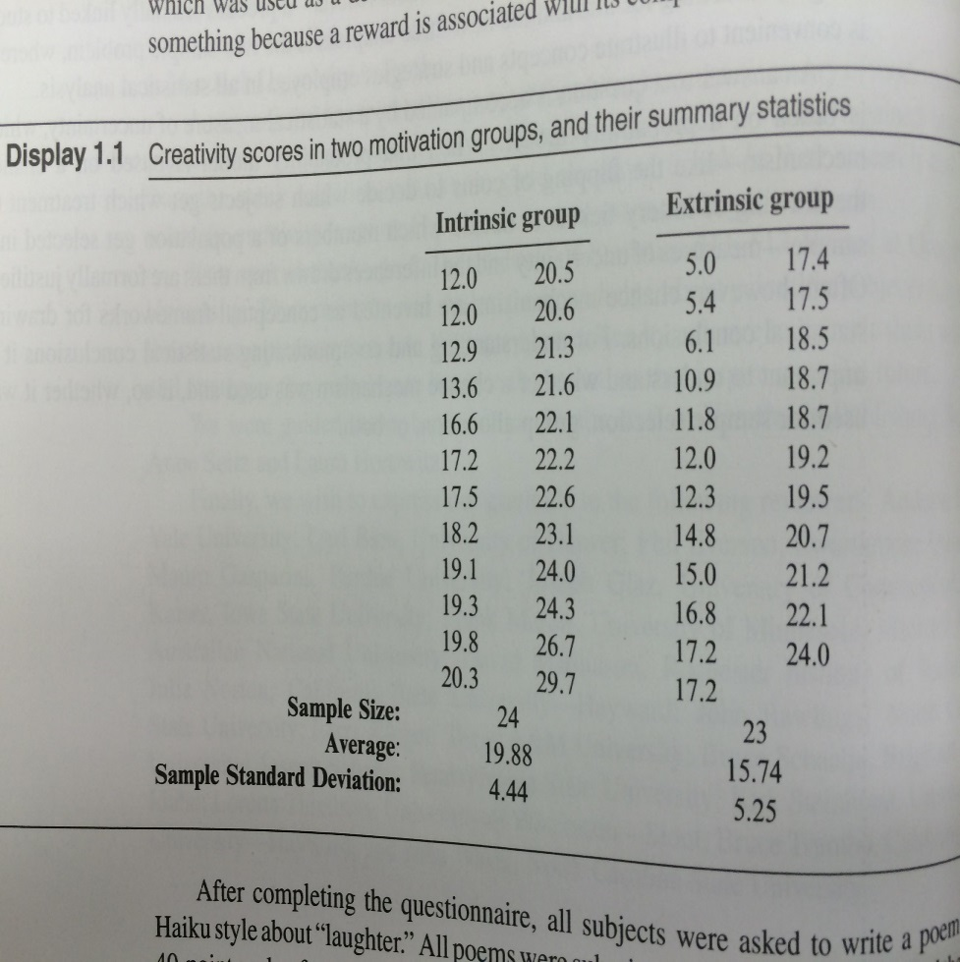
Causal Inference: Randomized vs. Observational Study
Causal inferences can be drawn from randomized experiments
Causal inferences cannot be drawn from observational studies due to Confounding
What are some possible confounding variables in the gender/salary study?
In the starting salaries study, maybe males in this study had
more education
more seniority
more age (older)
More willingness to negotiate starting salary
Younger
oyyoyyyoyoo
oooyyyoyoyy
oyyoyyyoyooy
oooyyyoyoyy
Older
In a randomized experiment, variables like age are also randomly distributed to each group, removing the confounding effect.

Slide 12
Causal Inference: Randomized vs. Observational Study
Causal inferences can be drawn from randomized experiments
Causal inferences cannot be drawn from observational studies due to Confounding
What are some possible confounding variables in the gender/salary study?
In the starting salaries study, maybe males in this study had
more education
more seniority
more age (older)
More willingness to negotiate starting salary
Rural
UURRUURUR
UURRUURUR
UURUUURURU
UURUUURURU
Urban
In a randomized experiment, variables like age are also randomly distributed to each group, removing the confounding effect.

Slide 13
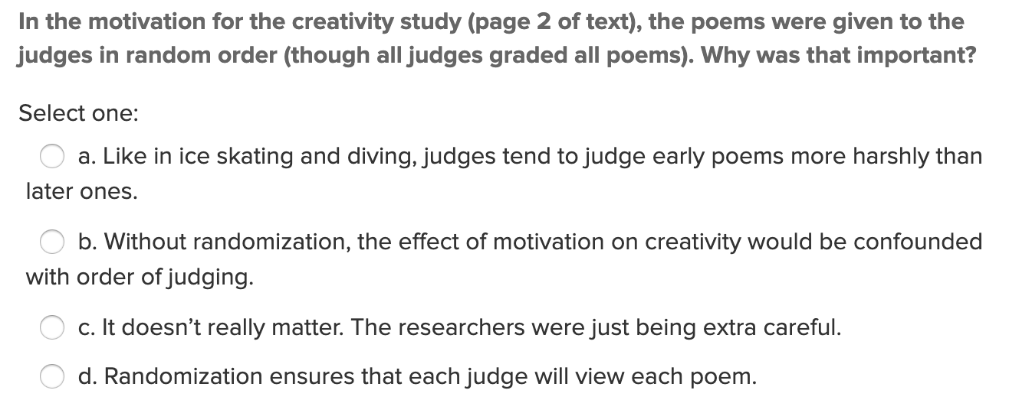
Quick Quiz Question 1 (QQ1)

Slide 14
Break Out 1

Slide 15

Question 2 ($≤1 hour)$
What is the difference between a randomized experiment and a random sample? Under what type of study/sample can a causal inference be made?

Slide 16
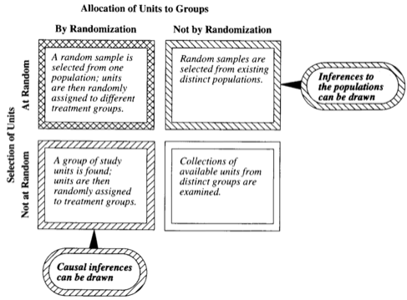
Question 2 ($≤1 hour)$
What is the difference between a randomized experiment and a random sample? Under what type of study/sample can a causal inference be made?
Inference is to only those in the sample.
Association

Slide 17
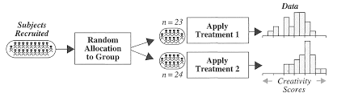
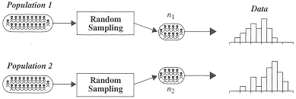
Another Look…
Randomized Experiment
Random Samples
Observational Study

Slide 18
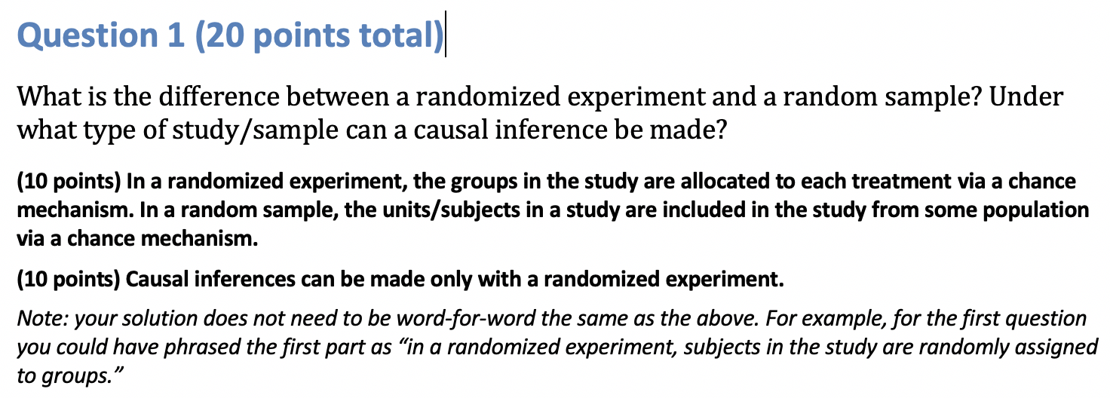
Question 2: A Solution

Slide 19

Question 3 ($1 hour)$
In 1936, the Literary Digest polled 1 out of every 4 Americans and concluded that Alfred Landon would win the presidential election in a landon-slide (pun intended:). Of course, history turned out dramatically different (see http://historymatters.gmu.edu/d/5168/ for further details). The magazine combined three sampling sources: subscribers to its magazine, phone number records, and automobile registration records. Comment on the desired population of interest of the survey and what population the magazine actually drew from.

Slide 20
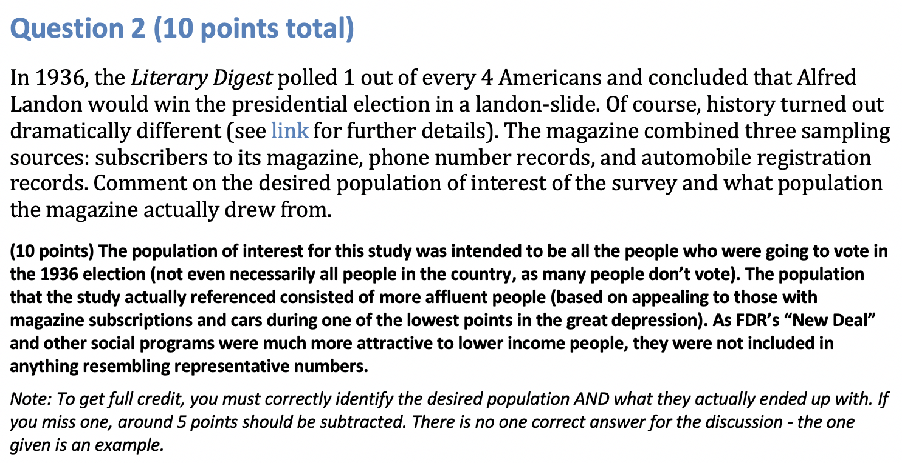
Question 3: A Solution

Slide 21
End Break Out 1

Slide 22
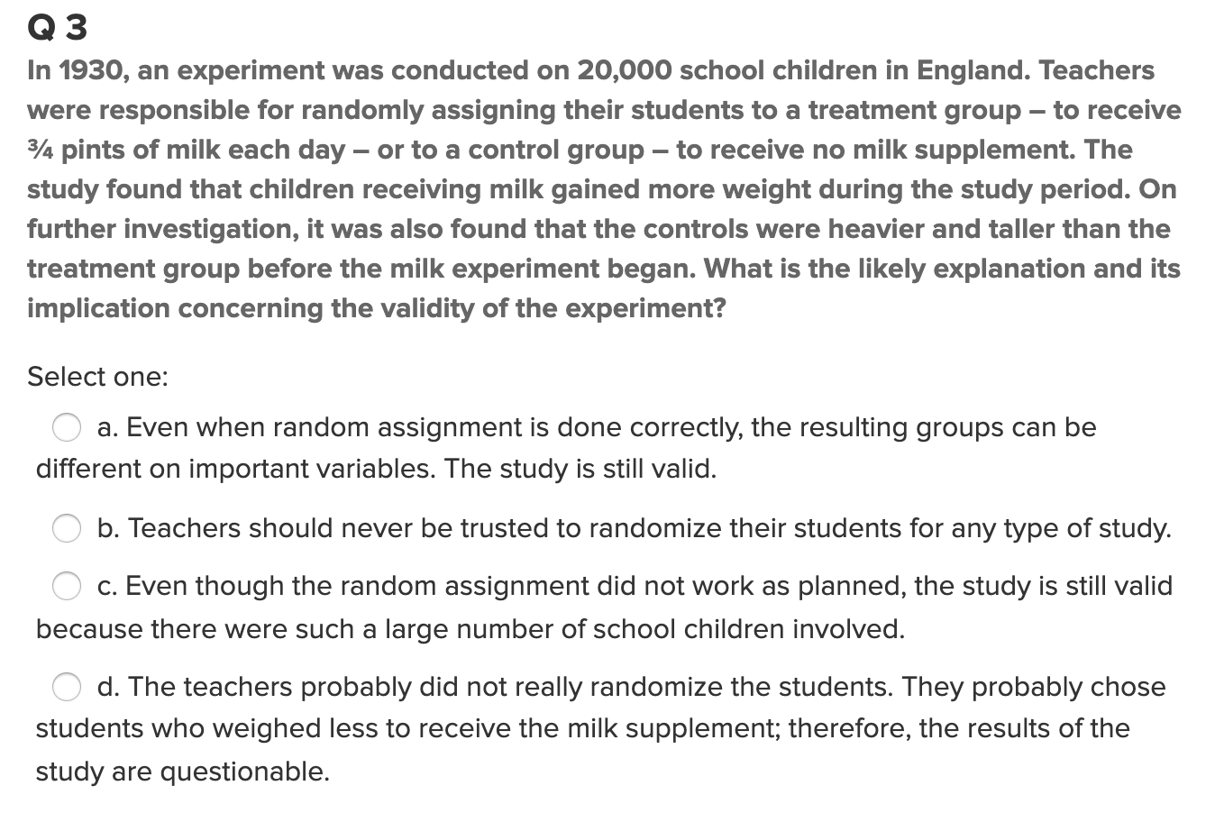
Quick Quiz Question 3 (QQ3)

Slide 23
Break Out 2

Slide 24
Question 4 (1 hours)
Suppose we have developed a new fertilizer that is supposed to help corn yields. This fertilizer is so potent that a small vial of it sprayed over an entire field is a sufficient dose. We find that the new fertilizer results in an average yield of 60 more bushels over the old fertilizer with a p-value of 0.0001. Write up a scope of inference under the following study designs that generated this data.
We offer the new fertilizer at a discount to customers who have purchased the old fertilizer along with a survey for them to fill out. Some farmers send in the survey after the growing season, reporting their crop yield. From our records, we know which of these farmers used the new fertilizer and which used the old one.
When a customer makes an order, we randomly send them either the old or new fertilizer. At the end of the season, some of the farmers send us a report of their yield. Again, from our records, we know which of these farmers used the new fertilizer and which used the old.

Slide 25
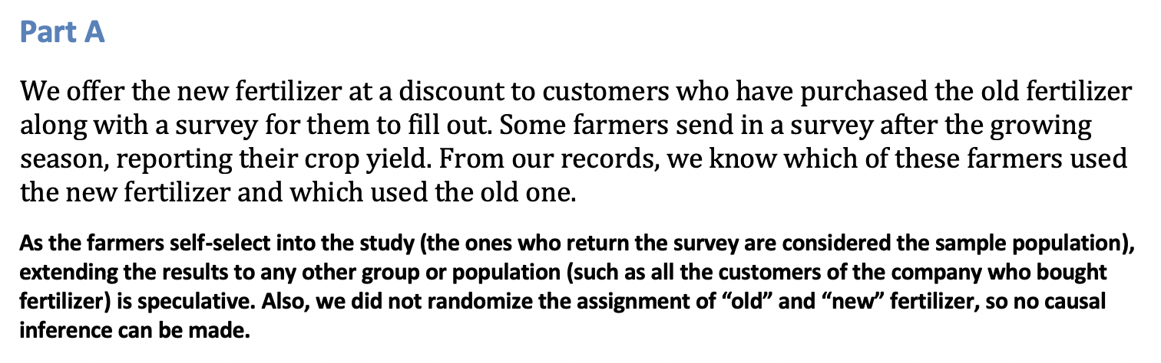
Question 4a
Suppose we have developed a new fertilizer that is supposed to help corn yields. This fertilizer is so potent that a small vial of it sprayed over an entire field is a sufficient dose. We find that the new fertilizer results in an average yield of 60 more bushels over the old fertilizer with a p-value of 0.0001. Write up a scope of inference under the following study designs that generated this data.
x

Slide 26
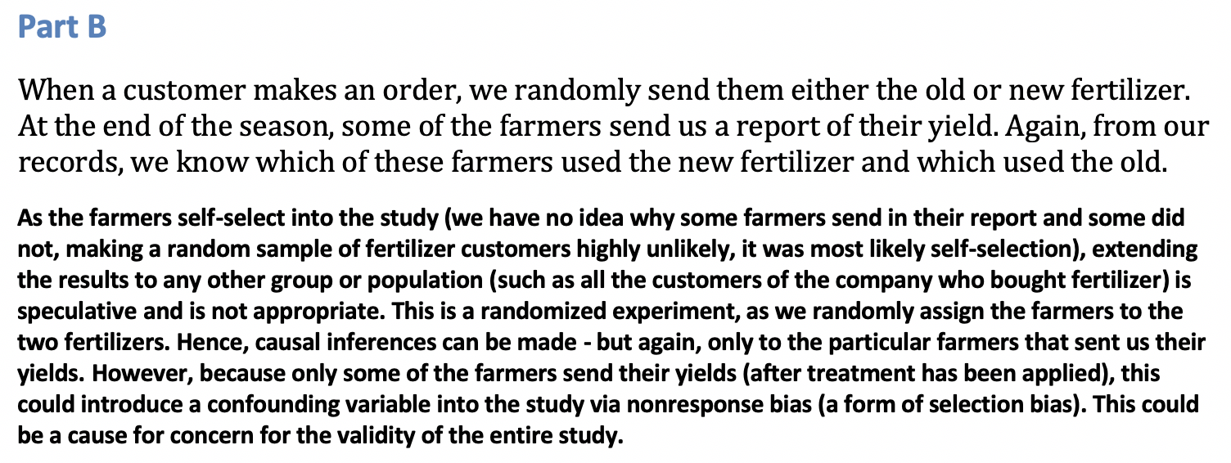
Question 4b
x
Suppose we have developed a new fertilizer that is supposed to help corn yields. This fertilizer is so potent that a small vial of it sprayed over an entire field is a sufficient dose. We find that the new fertilizer results in an average yield of 60 more bushels over the old fertilizer with a p-value of 0.0001. Write up a scope of inference under the following study designs that generated this data.

Slide 27
End Break Out 2

Slide 28
Break Out 3

Slide 29

Practice with Scope: Q1
x
A particular study focused on high school freshman and seniors and their GPAs in a required economics class. The study consisted of enumerating every freshman and senior in the school and randomly selecting them from that sampling frame. Their scores in the economics class were then recorded, and a hypothesis test for the difference of means was conducted. The seniors were found to have a significantly greater mean score in the class than the freshman. What sort of conclusions can be made from this study? In other words, what is the scope of this study? In this class, scope typically constitutes both the causal inferences and populations inferences.
Since the subjects cannot be randomly assigned to be freshman or seniors, this is an observational study, and thus the difference in mean scores is only associated with the freshman / senior status. We can’t tell if the class (freshman or senior) caused the difference or not.
The sample was a random sample from the school; therefore, these findings can be generalized to all freshman and seniors in the school. In conclusion, it can be inferred that the mean economics score of the seniors in the school is greater than that of the freshman although the cause of this difference cannot be determined from this study.

Slide 30
Practice with Scope: Q2
x
The Navy is very interested in the effects of sleep deprivation on cognitive ability. In order to test the effect, the Navy put out a radio advertisement asking for 18 to 35 year old nonsmokers to participate in the study. The volunteers were then placed in either the control group (no sleep deprivation) or the treatment group (36 hours of sleep deprivation) based on the flip of a fair coin (Heads = Control, Tails = Treatment). After the data was collected, the sleep deprived group was found to have a significantly lower mean math score than the group not deprived of sleep. What sort of conclusions can be made from this study? In other words, what is the scope of this study (causal inferences and population inferences)?
Since the subjects were randomly assigned to the control and treatment groups, this is a randomized experiment; thus, the difference in mean scores can be concluded to be caused by the sleep deprivation. Since the subjects were volunteers who responded to a radio advertisement, it is easy to see that every member of the population did not have the same chance of being selected, and thus the sample is NOT a random sample. Therefore these findings cannot be generalized to all U.S. nonsmokers between the age of 18 and 35. In conclusion, it can be inferred that sleep deprivation caused the decrease in cognitive ability (as measured by the timed math test) for these 57 individuals only.

Slide 31
End Break Out 3

Slide 32
Review: Strategy of Hypothesis Testing

Slide 33
Break Out 4

Slide 34
Pvalue … from FLS
How do you try to keep everything with p-value and rejecting the null straight in your head? Any nice memory tricks?
Once one understands what a pvalue actually is (and it does take time and repeated effort and thought) it does not need to be memorized. The pvalue is the probability of observing a result by random chance as extreme or more extreme than what was observed under the assumption the null hypothesis is true ... therefore .. if the pvalue is very small then we would not expect to see the results we obtained if the reality represented by the null hypothesis is true.. .thus we would reject it and say the evidence suggests the reality represented by the alternative hypothesis to be true. Ho and Ha represent two possible realities and we have to judge objectively which one is more in line with the evidence (data) we observed. The pvalue simply reflects the probability we would see the result we saw if the Ho version of reality it true.

Slide 35
Question / Activity 5 (2-3 hours)
With respect the Creativity Study you read in the Statistical Sleuth, use the code provided to conduct a permutation test to test for a difference in mean score between those motivated intrinsically and extrinsically.
Recommended approach:
Reread the material in the book and really think about it.
Review the code provided and run it a few times … try to make sense of the output and how it is generated.
Check out the video resource that fully explains the code.
Bring your questions to Live Session and place them at the end of the powerpoint deck.

Slide 36
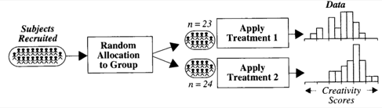
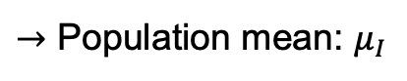
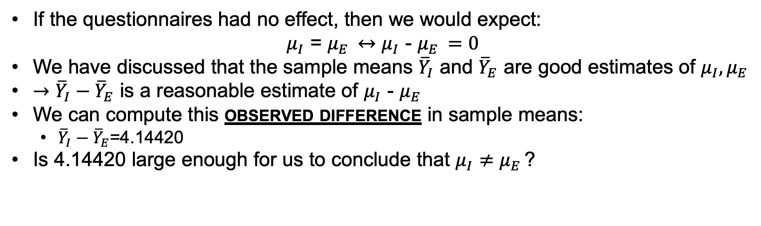
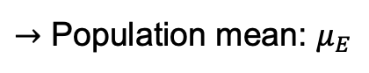
Creativity Study
$→$ Population mean: $μ_{I}$
I
I
$→$ Population mean: $μ_{E}$
E
If the questionnaires had no effect, then we would expect:
$μ_{I}$ = $μ_{E }↔μ_{I}$ - $μ_{E }=0$
We have discussed that the sample means ${\overline{Y}}_{I}$ and ${\overline{Y}}_{E}$ are good estimates of $μ_{I}, μ_{E }$
$→{\overline{Y}}_{I}−{\overline{Y}}_{E}$ is a reasonable estimate of $μ_{I}$ - $μ_{E }$
We can compute this observed difference in sample means:
${\overline{Y}}_{I}−{\overline{Y}}_{E}$=4.14420
Is 4.14420 large enough for us to conclude that $μ_{I}$ $≠$ $μ_{E }$?
(null hypothesis)
(test statistic)
(alternative hypothesis)

Slide 37
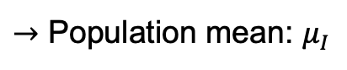
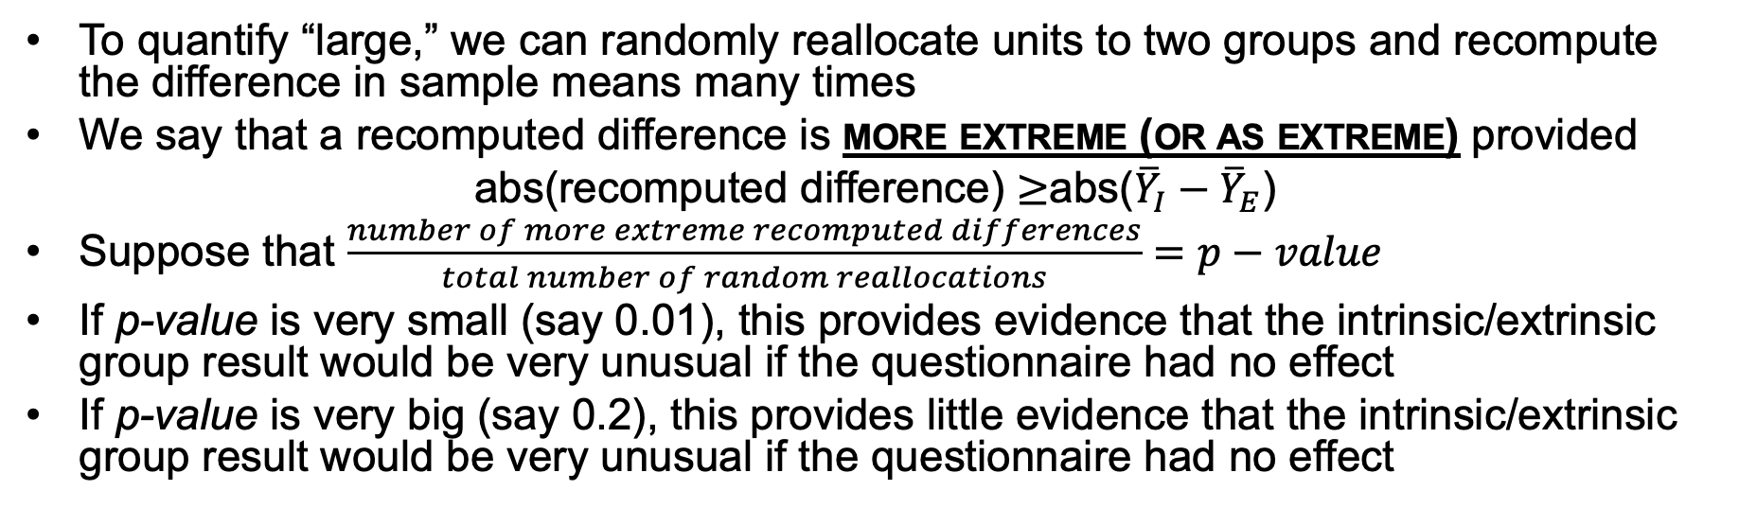
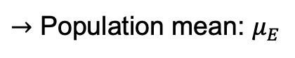
Creativity Study: all 47 subjects
$→$ Population mean: $μ_{I}$
I
$→$ Population mean: $μ_{E}$
E
To quantify “large,” we can randomly reallocate units to two groups and recompute the difference in sample means many times
We say that a recomputed difference is more extreme (or as extreme) provided
abs(recomputed difference) $≥$abs(${\overline{Y}}_{I}−{\overline{Y}}_{E}$)
Suppose that $\frac{number of more extreme recomputed differences}{total number of random reallocations}=p−value$
If p-value is very small (say 0.01), this provides evidence that the intrinsic/extrinsic group result would be very unusual if the questionnaire had no effect
If p-value is very big (say 0.2), this provides little evidence that the intrinsic/extrinsic group result would be very unusual if the questionnaire had no effect
(p-value)

Slide 38
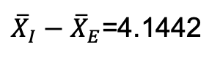
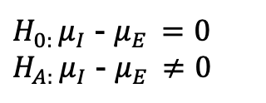
Creativity Study
$H_{0: }μ_{I}$ - $μ_{E }=0$
$H_{A: }μ_{I}$ - $μ_{E }≠0$
Assumption:
The intrinsic / extrinsic treatment has no effect on creativity.
(The mean creativity score of the intrinsic group is equal to the mean score of the extrinsic group.)
Evidence:
The difference in the mean from the sample that received the intrinsic motivation was 4.14 points higher than the mean from the sample that received the extrinsic motivation.
Probability:
${\overline{X}}_{I}−{\overline{X}}_{E}$=4.1442

Slide 39
Go Over SAS and R Permutation Test Code

Slide 40
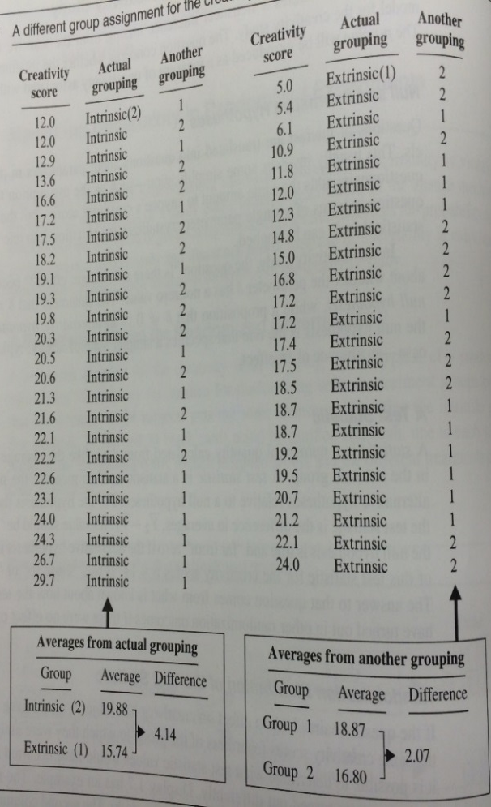
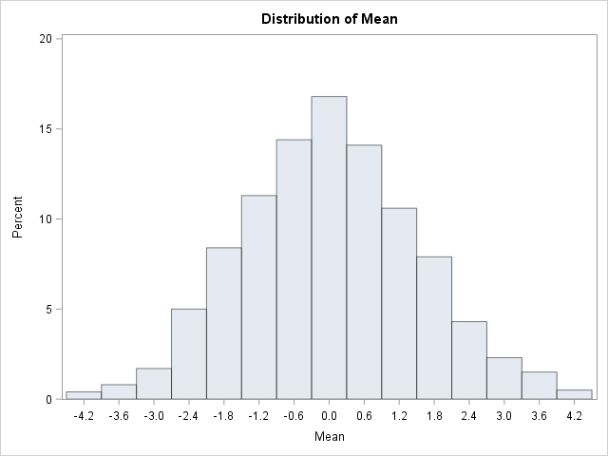
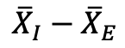
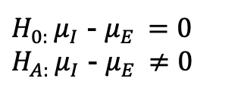
Creativity Study: Pvalue
$H_{0: }μ_{I}$ - $μ_{E }=0$
$H_{A: }μ_{I}$ - $μ_{E }≠0$
1000 different groupings (relabelings)*
Number of random regroupings:
1.6 x 10¹³
Half a year with a computer that can perform a million calculations per second!
$${\overline{X}}_{I}−{\overline{X}}_{E}$$
*Everyone has the same score with each grouping. What group each person is artificially put in changes with each regrouping. If the treatments had the same effect, then each participant would have the same score regardless of grouping.

Slide 41
Creativity Study
(go to SAS code)
The TTEST Procedure
Variable: score
treatment | Method | Mean | 95% CL Mean |  | Std Dev | 95% CL Std Dev
0 |  | 19.8833 | 18.0087 | 21.7580 | 4.4395 | 3.4504 | 6.2276
1 |  | 15.7391 | 13.4677 | 18.0105 | 5.2526 | 4.0623 | 7.4343
Diff (1-2) | Pooled | 4.1442 | 1.2914 | 6.9970 | 4.8541 | 4.0261 | 6.1138
Diff (1-2) | Satterthwaite | 4.1442 | 1.2776 | 7.0108

Slide 42
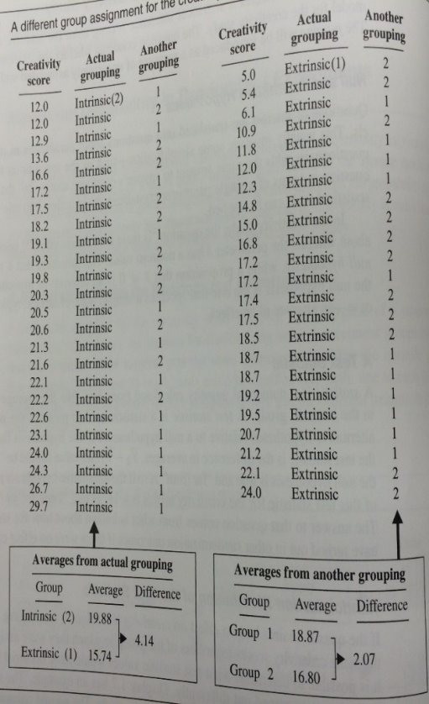
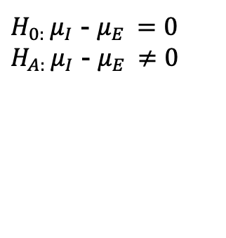
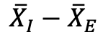
Creativity Study
Assumption:
The intrinsic / extrinsic treatment has no effect on creativity.
(The mean creativity score of the intrinsic group is equal to the mean score of the extrinsic group.)
Evidence:
The difference in the mean from the sample that received the intrinsic motivation was 4.14 points higher than the mean from the sample that received the extrinsic motivation.
Probability:
The estimated probability that a difference 4.14 or larger in sample mean scores would occur if there was not an effect is .008.
$H_{0: }μ_{I}$ - $μ_{E }=0$
$H_{A: }μ_{I}$ - $μ_{E }≠0$
-4.14
4.14
1000 different groupings (relabelings)
$${\overline{X}}_{I}−{\overline{X}}_{E}$$
P-value = 8/1000
= 0.008
Obs | Variable | Class | Method | Variances | Mean | LowerCLMean | UpperCLMean | StdDev | LowerCLStdDev | UpperCLStdDev | UMPULowerCLStdDev | UMPUUpperCLStdDev
1 | COL139 | Diff (1-2) | Pooled | Equal | 4.4678 | 1.6594 | 7.2762 | 4.7786 | 3.9635 | 6.0187 | 3.9360 | 5.9708
2 | COL170 | Diff (1-2) | Pooled | Equal | -4.3192 | -7.1485 | -1.4899 | 4.8141 | 3.9930 | 6.0634 | 3.9653 | 6.0152
3 | COL279 | Diff (1-2) | Pooled | Equal | -4.5576 | -7.3530 | -1.7623 | 4.7564 | 3.9451 | 5.9908 | 3.9178 | 5.9430
4 | COL360 | Diff (1-2) | Pooled | Equal | -4.8897 | -7.6340 | -2.1454 | 4.6695 | 3.8731 | 5.8814 | 3.8462 | 5.8345
5 | COL537 | Diff (1-2) | Pooled | Equal | 4.3826 | 1.5621 | 7.2031 | 4.7991 | 3.9806 | 6.0446 | 3.9530 | 5.9964
6 | COL551 | Diff (1-2) | Pooled | Equal | -5.0514 | -7.7692 | -2.3337 | 4.6243 | 3.8356 | 5.8245 | 3.8090 | 5.7781
7 | COL604 | Diff (1-2) | Pooled | Equal | -4.7109 | -7.4832 | -1.9385 | 4.7172 | 3.9127 | 5.9415 | 3.8855 | 5.8942
8 | COL664 | Diff (1-2) | Pooled | Equal | 4.6636 | 1.8840 | 7.4431 | 4.7295 | 3.9228 | 5.9569 | 3.8956 | 5.9095
Conclusion: There is strong evidence to suggest that the mean score of those who receive intrinsic motivation is not equal to (greater than) those who receive the extrinsic motivation (p-value = .008). Since this was a randomized experiment, we can conclude that the intrinsic motivation caused this increase. In addition, since these were volunteers, this inference can only be assumed to apply to these 47 subjects, although the findings are very intriguing.

Slide 43
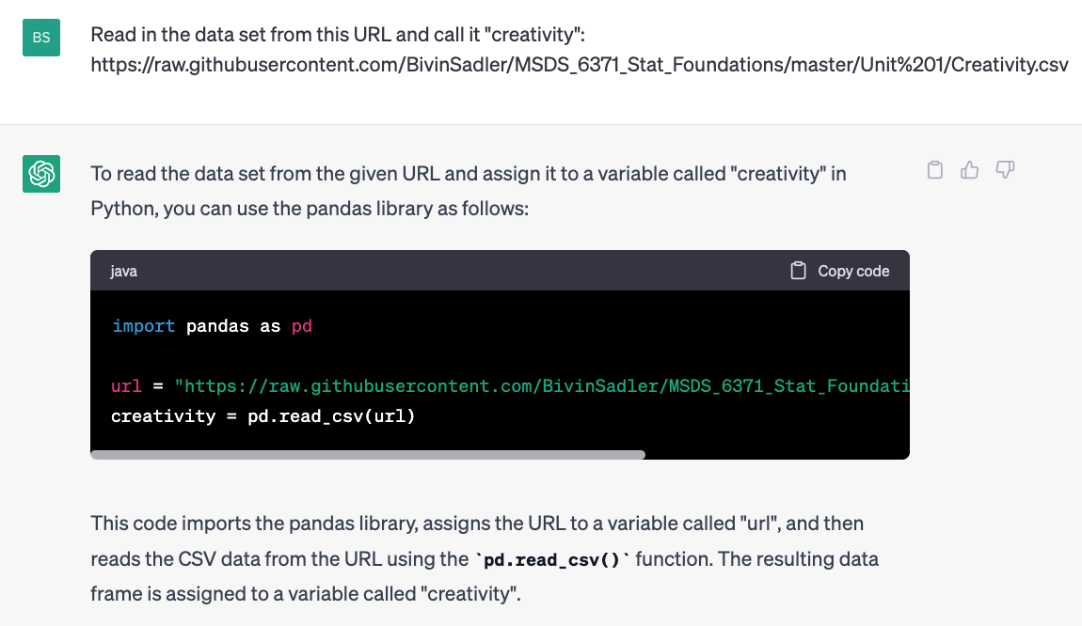
ChatGPT3.5

Slide 44
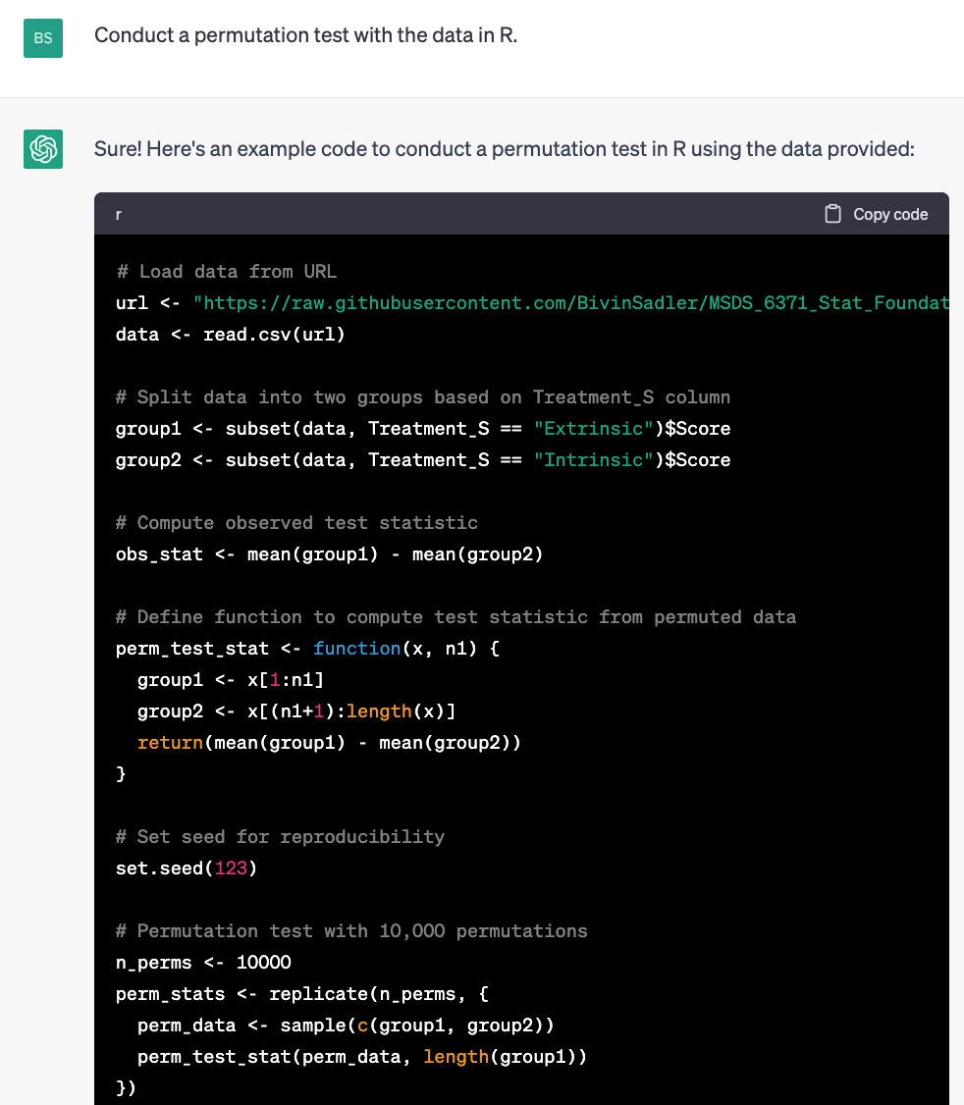
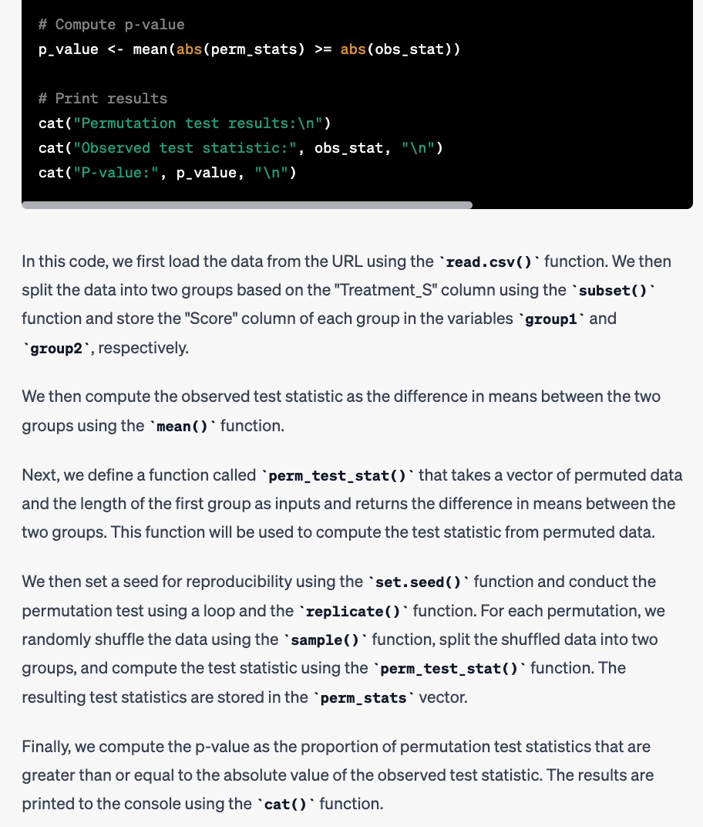
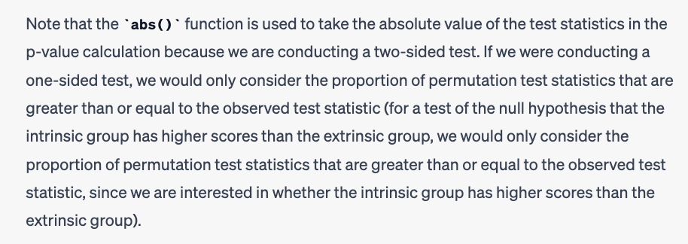
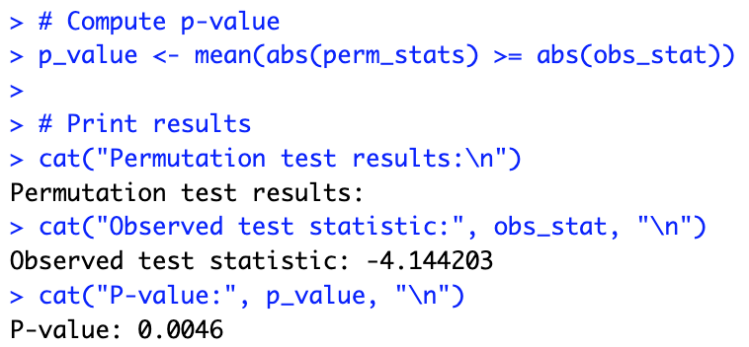
With ChatGPT3.5
Copied and Pasted Directly into Rstudio:

Slide 45
End Break Out 4

Slide 46
Question 6: Takeaways! (~ 1 Hour)
Please provide at least 4 takeaways from this section and any questions that you may have. These questions will help design the live session for this unit.
This question will be the last question of every For Live Session Assignment. The idea is that this deck will serve as a document that you can reference in the future to remember what was covered in this section. For instance, this may come in handy for the Capstone and will hopefully become useful in your career. Most immediately, it may become handy as a quick reference for your Midterm and Final! Some students find it very useful and spend a few slides summarizing the asynch material while others learn different ways and only had the minimum 4 takeaways. Either is fine and will earn you full credit for this question.

Slide 47
Question 7: Questions!
Please provide any question or topics of discussion that came up in this Unit! These will help help us optimize our live session for maximum learning and takeaways!
This question will be the last question of every For Live Session Assignment. The idea is that this deck will serve as a document that you can reference in the future to remember what was covered in this section. For instance, this may come in handy for the Capstone and will hopefully become useful in your career. Most immediately, it may become handy as a quick reference for your Midterm and Final! Some students find it very useful and spend a few slides summarizing the asynch material while others learn different ways and only had the minimum 4 takeaways. Either is fine and will earn you full credit for this question.

Slide 48
End of For Live Session: Unit 1

